Slide 1
Weston College – Apprenticeship Levy Solutions Service
Liz Redwood – Executive Director of Apprenticeships and Business Development
8th September 2016

Slide 2
3,000,000 Growth in Apprenticeships - nationally
That is equivalent to more than one apprentice starting every minute of every day over the next five years
Employer-designed standards in all areas of the economy
Degree Apprenticeships which combine a degree with practical skills gained in work and deliver valuable high-level technical skills
As part of wider growth, SFA will treble the number of Apprenticeships in food, farming and agri-tech

Slide 3
Apprenticeship Reforms
Employer Driven
Employers designing apprenticeships to make them more responsive to their needs and the future economy
Quality
Making apprenticeships more rigorous so that they are reviewed with the same esteem as university
Simplicity
Simplifying apprenticeship standards so that they are shorter and more accessible

Slide 4
The main changes
Standards designed by employers will replace existing frameworks
New standards will be clear and concise, written by employers and no more than a few pages long
All apprenticeships will last a minimum of 12 months
All apprenticeships will have an end-point assessment
Apprenticeships will be graded for the first time

Slide 5
Funding Reform
Government committed to employer routed funding
Less emphasis on speed and greater degree of deliberation
Recognition of concerns from SMEs and a commitment to address these
Compulsory cash contributions are a feature of new model
Apprenticeship Levy introduced for large employers

Slide 6
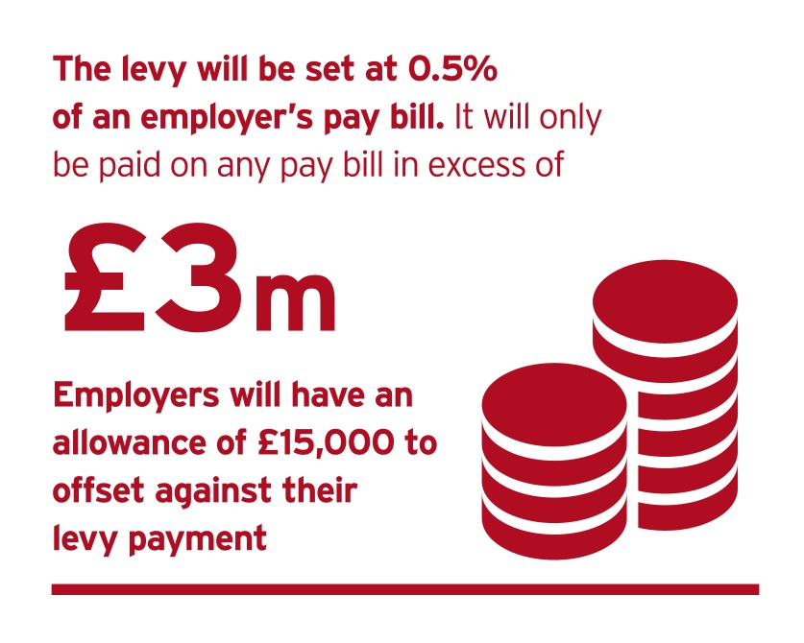
What is the Apprenticeship Levy?
Levy on UK employers will fund growth in the apprenticeship programme. In parallel, employers will be given more influence over how apprenticeships are designed and paid for, so that they focus on the skills, knowledge and behaviours that are required of the workforce of the future.
The levy will come into effect on 6 April 2017, at a rate of 0.5% of pay bill, paid through PAYE. It applies to all employers in all sectors.
All employers have an allowance of £15,000 to offset against their levy liability. The levy allowance is not a cash payment and cannot be used to purchase apprenticeship training
Employers in England who pay the levy will be able to get out more than they pay in – government will top-up to their digital accounts

Slide 7
How it will apply to businesses
Levy Paying Employer
Non-Levy Paying Employer
Employer of 250 employees, each with a gross salary of £20,000.
Pay bill: 250 x £20,000 = £5,000,000
Levy sum: 0.5% x £5,000,000 = £25,000
Allowance: £25,000 - £15,000 = £10,000 annual levy payment
Employer of 100 employees, each with a gross salary of £20,000.
Pay bill: 100 x £20,000 = £2,000,000
Levy sum: 0.5% x £2,000,000 = £10,000
Allowance: £10,000 - £15,000 = £0 annual levy payment
You will calculate, report and pay your levy to HMRC, through the Pay as You Earn (PAYE) process alongside income tax and National Insurance.
Single employers with multiple PAYE schemes will only have one allowance
Connected employers - Employers will share one allowance between employers which are in connected ownership or control.
You won’t be exempt from the apprenticeship levy if you already pay into an existing levy (I.E CITB levy)

Slide 8
Key updates following latest announcement
Levy will go ahead from April 2017
Start date for accessing the new funding system – 1st May 2017
System applies to both Levy and non-levy paying employers
Starts prior to 1st May will be funded under current funding terms and conditions
15 funding bands proposed, with the upper limit of these bands ranging from £1,500 to £27,000
All existing and new apprenticeship frameworks and standards will be placed within one of these funding bands
Co-investment is a requirement of the new system for non-levy paying employers or employers who have used up their levy it is proposed that employers co-invest 10% of the costs, with government paying the remaining 90%

Slide 9
Information update
For small employers (less than 50 employees) it is proposed to waive the co-investment element if these employers take on a 16 to 18 year old apprentice
English & Maths Functional Skills funding will not require an employer contribution nor will it be taken from levy paying employer’s accounts it will continue to be paid directly to the provider
Re-training – proposed that eligible learners will be able to undertake Apprenticeships at a lower level than their current education level ‘to acquire substantive new skills’

Slide 10
What can you use your Levy for?
FUNDS CAN BE USED FOR:
apprenticeship training and assessment
(with an approved training provider I.E Weston College)
FUNDS CANNOT BE USED FOR:
wages
statutory licences to practise
travel and subsidiary costs
managerial costs
traineeships
work placement programmes
the costs of setting up an apprenticeship programme

Slide 11
Purchasing Training
The new funding system comes into effect on 1 May 2017, because May is the first month that levy paying employers will declare a levy payment to HMRC. All apprenticeships started before 1 May will be funded through to completion according to the existing rules. Any employer contribution towards training commenced before 1 May will also continue at the current rate.
Levied employers buying training from May 2017
As soon as an employer has funds in their levy account they will be able to select a provider and an apprenticeship programme and commit to this. By committing to apprenticeship training via the digital account, the employer will be entering into a contract agreement with the provider.
Once committed to training, funds will automatically leave the employer’s digital account on a monthly basis, spread over the lifetime of the apprenticeship.
Govt propose to hold back 20% of the total cost, to be paid on completion of the apprenticeship.
Information and tools in the digital account will help employers forecast the funds that are likely to accumulate in their account over time and manage cash flow.
Non-levied employers buying training from May 2017
Employers that don’t pay the levy will make payments for training direct to providers.
We will move them onto the digital system at a later date.

Slide 12
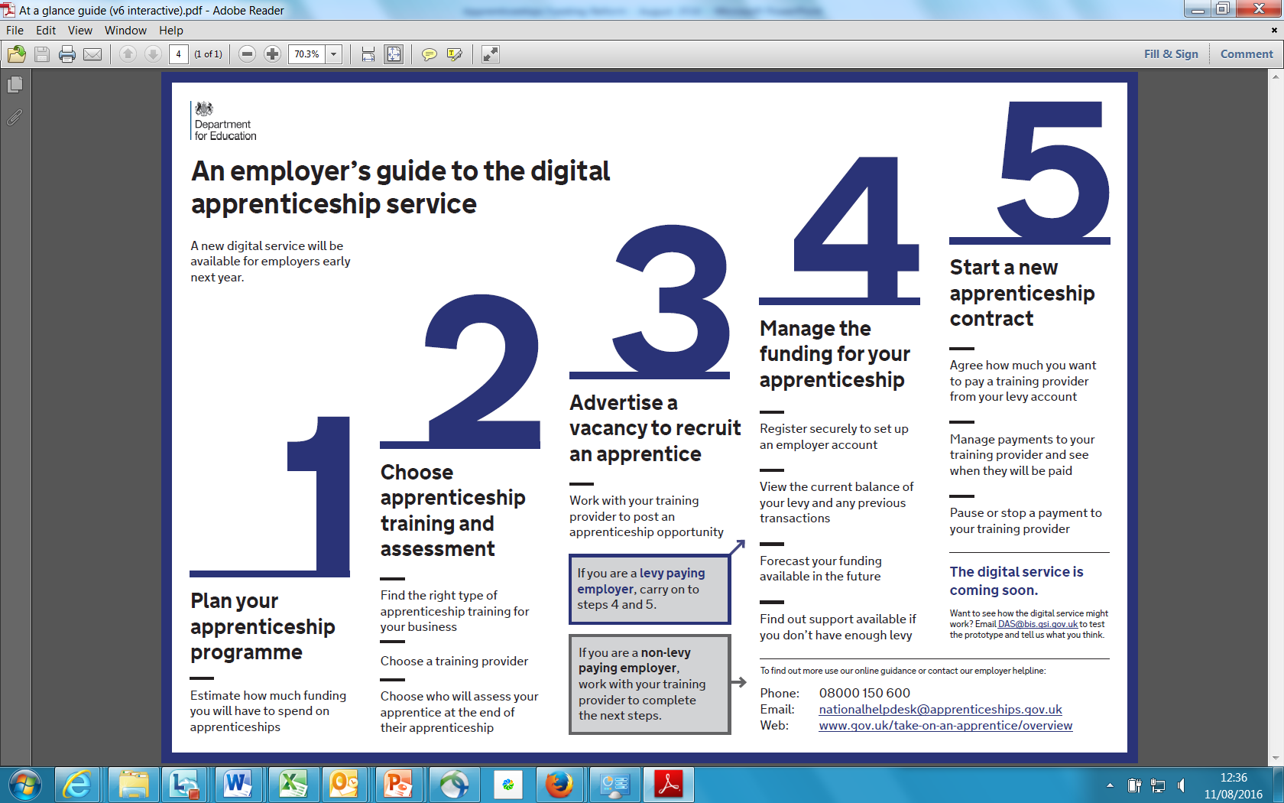
The process

Slide 13
Timeline
SUMMER 2016
AUTUMN 2016
DEC 2016
APRIL 2017
High level scope
Operating detail
Transition
Operation
BIS/DfE publish provisional funding rates for different elements of the new funding regime in August
BIS/DfE publish confirmed funding rates for April 2017
SFA publish provisional funding rules
SFA publish confirmed funding rules
Full set of confirmed funding guidelines published
Digital apprenticeship service registration opens
Apprenticeship Levy operational
digital apprenticeship service operational
New funding model live
Institute for Apprenticeships in place
Calculate annual pay bill and Levy commitment
Identify existing employee training needs
Identify recruitment needs for 2016 – 2018
Create Apprenticeship Training plan/cycle

Slide 14
Weston College Levy Solution Service

Slide 15
How Apprenticeships can work for you
Example of Apprenticeships working throughout Downtons
Sales and Customer Facing Teams | Finance and Administration Teams | Team Leading and Management Teams | Logistics, Retail and Supply Chain
Contact Centre Operations Customer Service Sales and Marketing | Accountancy Business Administration IT and Digital | Team Leading Operational Management Project Management | Retail Supply Chain Operative Warehouse Operative
Higher and Degree Apprenticeships
IT Professional Degree Apprenticeship |  | Chartered Manager Degree Apprenticeship

Slide 16
Questions and discussion

